Slide 1

Deep Learning Based Product Reordering Prediction
Title: Deep Learning Based Product Reordering Prediction Domain: E-Commerce | Retail | Customer Analytics

Slide 2

Problem Statement : Predict whether a user will reorder a product again based on their past purchase behavior using deep learning models. To build a deep learning model that predicts whether a customer will reorder a product based on their past purchasing behavior. This helps improve customer experience, inventory planning, and marketing efforts in e-commerce.

Slide 3
Dataset: Instacart Market Basket Analysis
Files Used:
orders.csv
order_products__prior.csv
order_products__train.csv
products.csv, aisles.csv, departments.csv Format: CSV Key Features: user_id, product_id, order_dow, order_hour_of_day, days_since_prior_order, reordered

Slide 4

Business Use Cases
🛒 Personalized Recommendations – Suggest products likely to be reordered.
📦 Inventory Management – Predict demand to reduce over/understocking.
🔁 Customer Retention – Spot drop in reordering to reduce churn.
💰 Marketing Optimization – Trigger personalized offers for high-likelihood products.

Slide 5
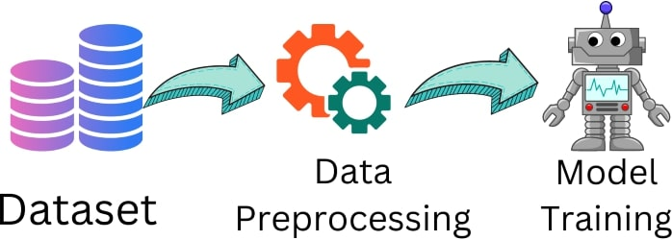
Preprocessing Steps
Dropped irrelevant columns (like product names).
Handled missing values.
Normalized numeric features using StandardScaler.
One-hot encoded target labels (reordered = 0/1).

Slide 6

Feature Engineering
User Features – total orders, reorder ratio, days between orders.
Product Features – reorder rate, frequency of orders.
User-Product Features – how often a user reorders a product.
Time Features – weekend vs weekday, morning vs night orders.

Slide 7
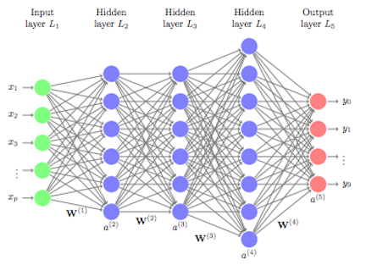
Model Building
Model Building
Architecture: Feedforward Deep Neural Network (DNN)
Layers:
200 → 150 → 100 → 50 → 20 → 1
Activation: ReLU (hidden layers), Sigmoid (output)
Loss Function: Binary Crossentropy
Optimizer: Adam
Regularization: EarlyStopping

Slide 8
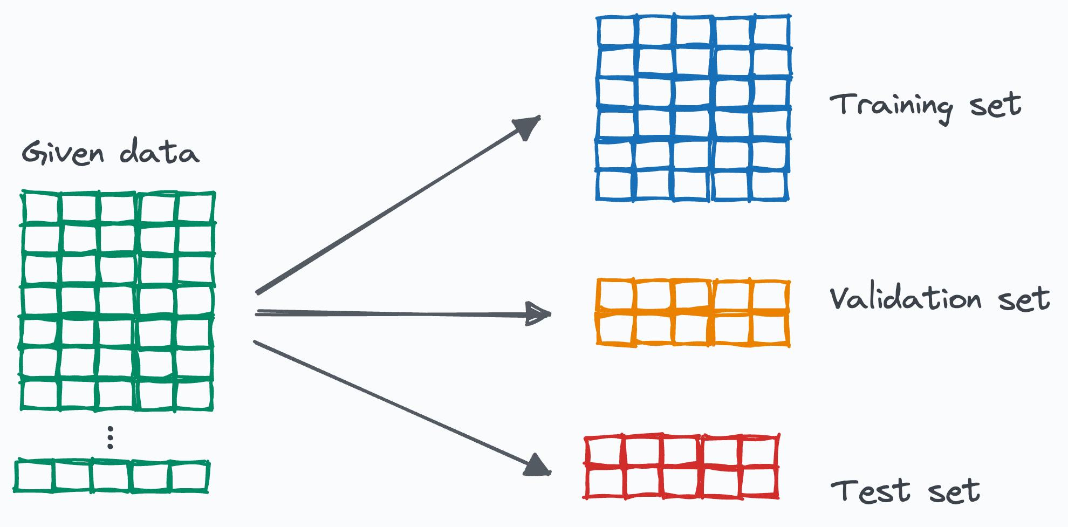
Training & Validation
80:20 Train-Test Split
10% validation from training data
Used callbacks to monitor overfitting
Trained for 50 epochs with batch size 15/16

Slide 9
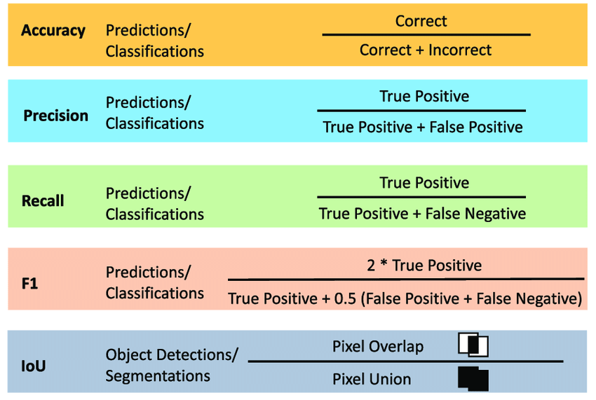
Evaluation Metrics
Evaluated using:
Accuracy
Precision
Recall
F1-Score
ROC-AUC Score
Confusion Matrix

Slide 10
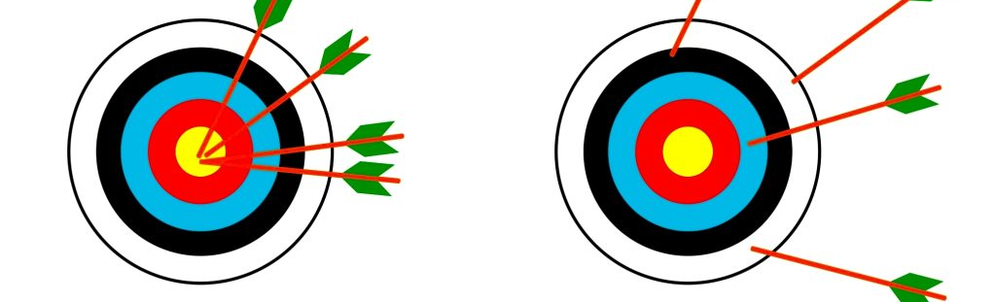
✅ Accuracy
Training Accuracy (85.28%): Your model correctly predicted reorders 85 times out of 100 during training.
Validation Accuracy (82.39%): On unseen data, the model still performs well, which indicates good generalization.
✅ Loss
Training Loss (0.3158) and Validation Loss (0.4107) are relatively close, showing:
No major overfitting (model performs similarly on training and validation).
Your model is well-tuned and stable.

